Slide 1


Building a Finite State Automaton for Token Recognition
DSA0304 – Natural Language Processing
Presented by:
G.V.S.HEMANTH(192425186)
Guided By:
Dr.T.Devi

Slide 2
Introduction
Overview of the Project:
Finite State Automata (FSA) is a mathematical model used to recognize patterns and process input strings.
It consists of states, transitions, a start state, and one or more final (accepting) states.
In Natural Language Processing (NLP), FSA is used to recognize words, tokens, and valid language patterns.
FSA plays an important role in lexical analysis, language recognition, spell checking, and text processing.

Slide 3
Objective & Token Types
Objectives
Design an FSA to recognize valid tokens.
Classify tokens into Identifiers, Keywords, and Numbers.
Reject invalid tokens.
Demonstrate token recognition using Python.
Understand the role of FSA in lexical analysis.
Token types
Identifiers: student, _count, value1
Keywords: if, else, while, return
Numbers: 123, 4567, 890

Slide 4
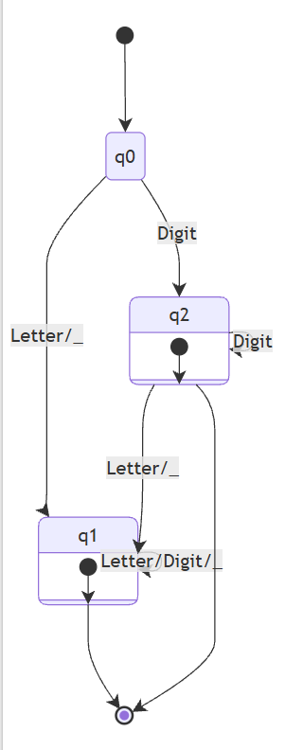
Working of FSA
Start from the initial state (q0).
Read one character at a time.
Move to the next state based on transition rules.
Continue until all characters are processed.
Accept the token if the final state is an accepting state; otherwise, reject it.
q0 = Start State
q1 = Identifier (Final State)
q2 = Number (Final State)

Slide 5


Applications of FSA in Natural Language Processing
Used for lexical analysis in compiler design.
Recognizes identifiers, keywords, and numbers in source code.
Performs tokenization in Natural Language Processing (NLP).
Supports text pattern matching and string recognition.
Used in syntax highlighting of code editors.
Validates user inputs such as identifiers and numeric values.
Powers regular expression matching in text processing.

Slide 6
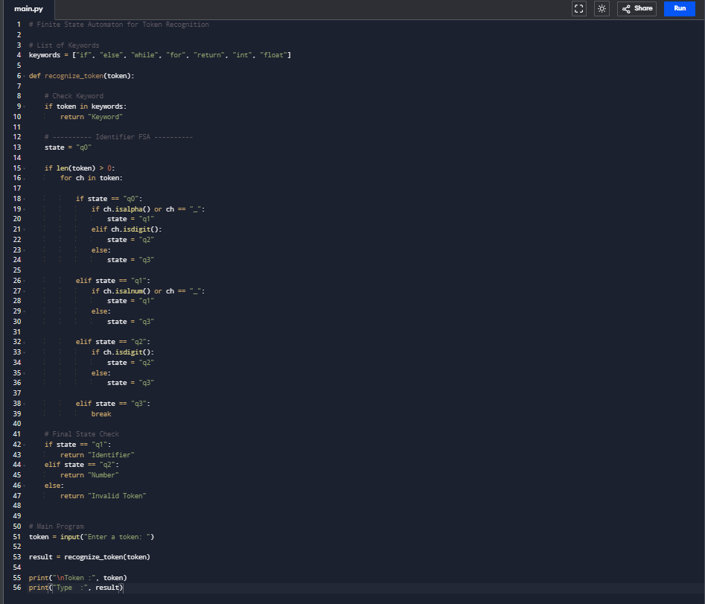
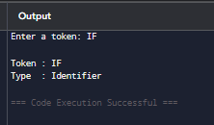
CODE
OUTPUT

Slide 7
CONCLUSION
The Finite State Automaton (FSA) was successfully designed to recognize identifiers, keywords, and numbers from textual input.
The automaton correctly classified valid tokens and rejected invalid tokens using predefined state transitions.
The implementation demonstrated how lexical analysis is performed efficiently by processing one character at a time.
FSA provides a simple, fast, and reliable approach for token recognition in Natural Language Processing (NLP) and compiler design.
The project shows that finite state automata form the foundation of lexical analyzers and help improve the accuracy and efficiency of text and source code processing.

Slide 8
Thank You!

